Slide 1
Predictive Modeling on Cryptocurrency Prices Using Regression Analysis
Team Members:
Divya Dodla (ua03330)
Naga Satya Sai Naren Kandregula (pw71937)

Slide 2

Background
Cryptocurrency is a digital or virtual form of currency that uses cryptography for secure, decentralized transactions over the internet.
Digital and Decentralized: Cryptocurrencies are digital assets that operate on decentralized networks using blockchain technology.
Secure and Anonymous: They offer enhanced security through cryptography and often provide anonymity in transactions.
Highly Volatile: Known for significant price fluctuations, adding both risk and potential for high returns.
Global Accessibility: Available to anyone with an internet connection, transcending traditional banking barriers.
Diverse Applications: Beyond transactions, they enable innovations like smart contracts and decentralized finance (DeFi).
References:
Tambe, N. (2023, December 6). Bitcoin price prediction: Can Bitcoin reach $1,000,000 by 2025? Forbes.
Narayanan, A., Bonneau, J., Felten, E., Miller, A., & Goldfeder, S. (2016). Bitcoin and cryptocurrency technologies: a comprehensive introduction. Princeton University Press.

Slide 3
Motivation and Business Understanding
This project is driven by the goal of harnessing advanced data science techniques to decode the complexities of the Bitcoin market, offering insights that are valuable for both educational purposes and practical financial decision-making.
Financial Market Insight: Analyze and understand Bitcoin market trends.
Data Science Application: Utilize advanced data science and machine learning techniques.
Predictive Analytics: Develop models to forecast Bitcoin prices.
Cryptocurrency Innovation: Contribute to new methods in cryptocurrency analysis.
Educational Benefit: Offer practical learning experience in data science.
Economic Relevance: Aid in investment decisions and risk management in crypto markets.
This project's insights and predictions offer valuable guidance for strategy, investment, and risk management in the ever-changing cryptocurrency market.
References:
Tambe, N. (2023, December 6). Bitcoin price prediction: Can Bitcoin reach $1,000,000 by 2025? Forbes.
Narayanan, A., Bonneau, J., Felten, E., Miller, A., & Goldfeder, S. (2016). Bitcoin and cryptocurrency technologies: a comprehensive introduction. Princeton University Press.

Slide 4
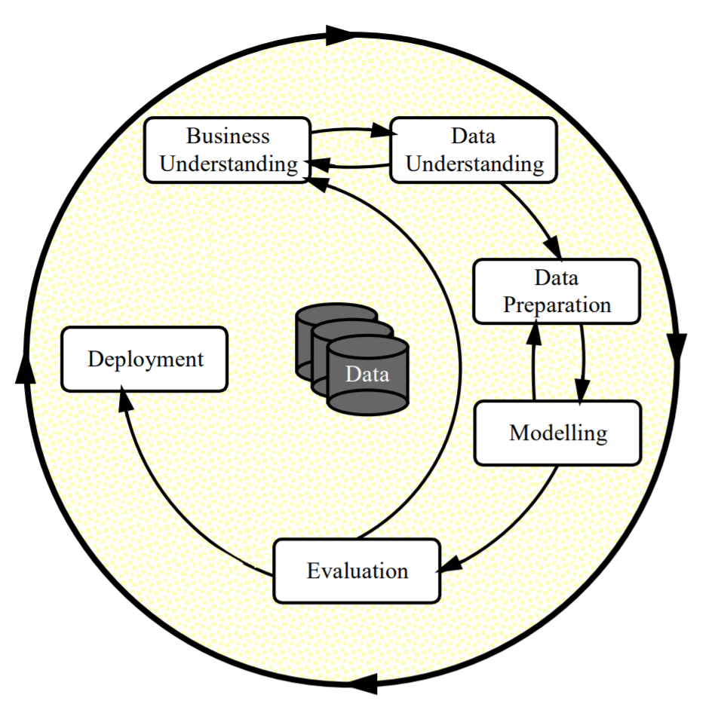
CRoss-Industry Standard Practice for Data Modeling (CRISP-DM)
Acquiring and preparing the Bitcoin dataset for analysis retrieved from the Yahoo historical data section of the Bitcoin USD (BTC-USD) page, involving data cleaning and normalization.
References:
Yahoo! (2023, December 19). Bitcoin USD (BTC-USD) price history &amp; historical data. Yahoo! Finance. https://finance.yahoo.com/quote/BTC-USD/history/?guccounter=1

Slide 5
Assumptions
We believe that prior price trends and patterns in cryptocurrency will continue to have some predictive ability.
We recognize that cryptocurrency markets are very volatile and influenced by a variety of external factors, making it difficult to attain high prediction accuracy.
It is assumed that the machine learning model possesses the ability to adapt to changing market conditions, ensuring it remains relevant and effective in capturing new patterns and trends as the cryptocurrency market evolves.
This project may not consider unforeseen events or news that can have a rapid and major influence on cryptocurrency values.

Slide 6
Feature Engineering
Key Indicators:SMA, EMA, MACD, RSI, Bollinger Bands, True Range, Williams %R.
Trader Tools: Aid in market analysis, trend assessment, and conditions identification.
Informed Decisions: Used individually or together for better trading decisions.
Trend Identification: SMA and EMA for trend spotting via crossovers.
MACD for Momentum: Identifies trend changes and momentum shifts.
RSI Signals: Overbought (sell) or oversold (buy) indications.
Bollinger Bands Volatility: Signals breakouts and reversals based on band proximity.
True Range Volatility: Measures price volatility using three ranges.
Williams %R Conditions: Identifies overbought and oversold market conditions.
Machine Learning Target: 'Adj Close' prices shifted for predicting next day's close.
These technical indicators are valuable tools for traders and analysts, offering insights into market conditions, trend changes, and overbought/oversold conditions, thus aiding in making well-informed trading and investment decisions.
References:
Levi, K. L. (2023, May 22). Best 10 indicators for cryptocurrency trading: Primexbt&nbsp;. PrimeXBT. https://primexbt.com/for-traders/best-indicators-for-cryptocurrency-trading/

Slide 7
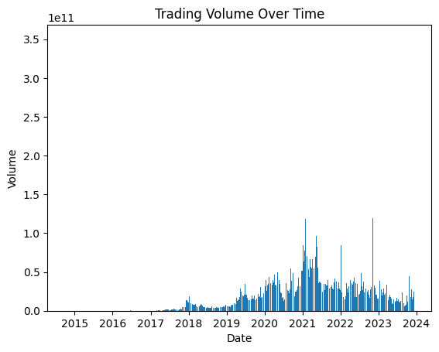
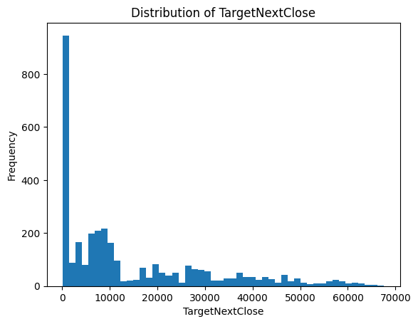
Exploratory Data Analysis (EDA)

Slide 8
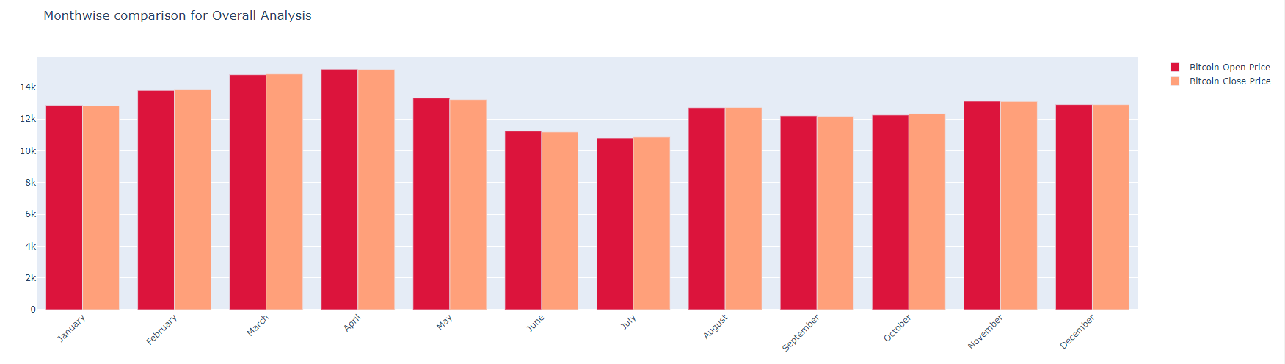
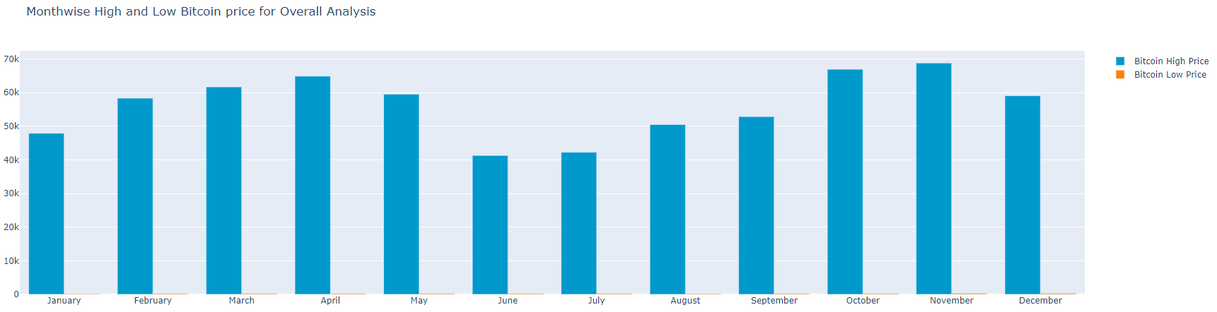

Slide 9
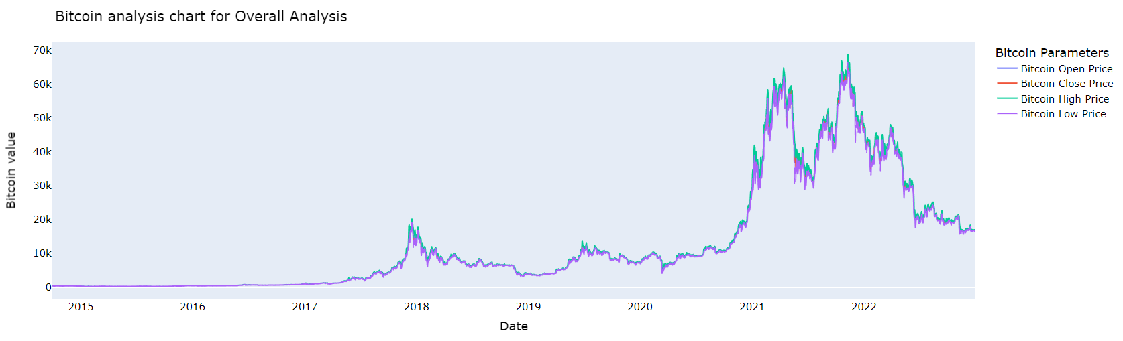

Slide 10
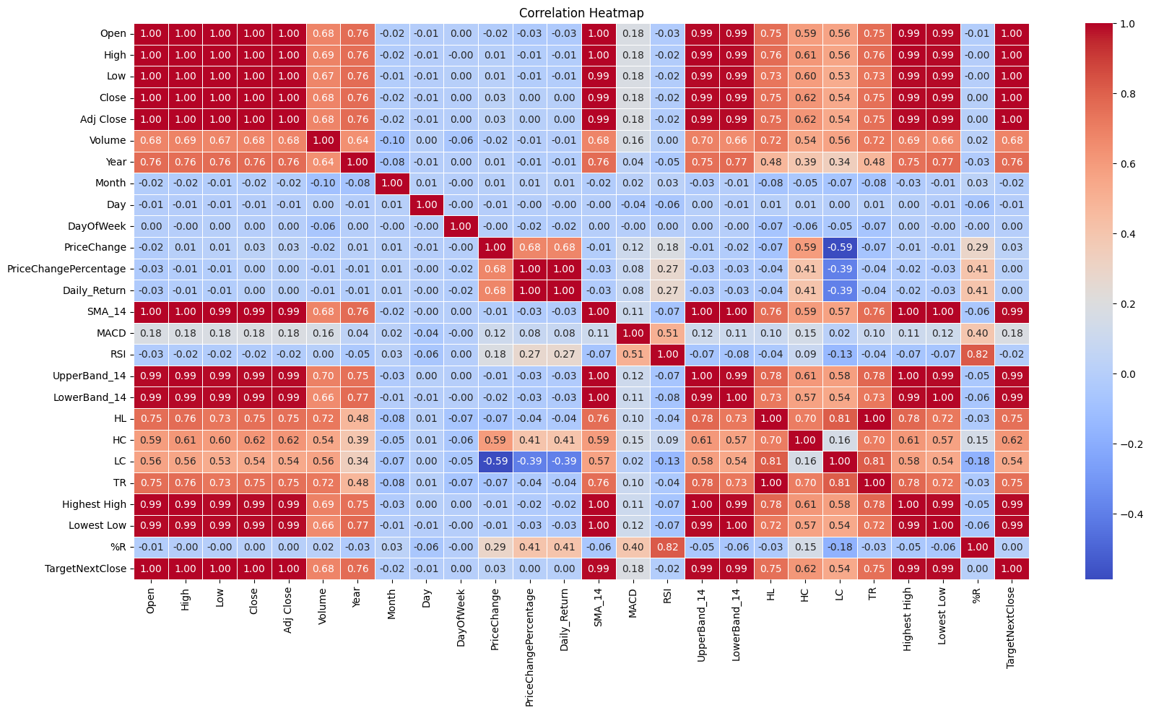
Correlation Matrix

Slide 11
Modeling Approach
Approach: Regression modeling chosen for cryptocurrency price prediction.
Model Diversity: XGBoost, LSTM, ARIMA models used for training and validation.
Data Split: Dataset divided into training, validation, and testing sets.
Training Process: Models trained on the training data; performance evaluated using metrics.
Best Model: Best-performing model selected based on evaluation metrics.
Testing Phase: Chosen model predicts on test data.
Future Forecasting: The selected model employed for forecasting future cryptocurrency prices beyond the test data.

Slide 12
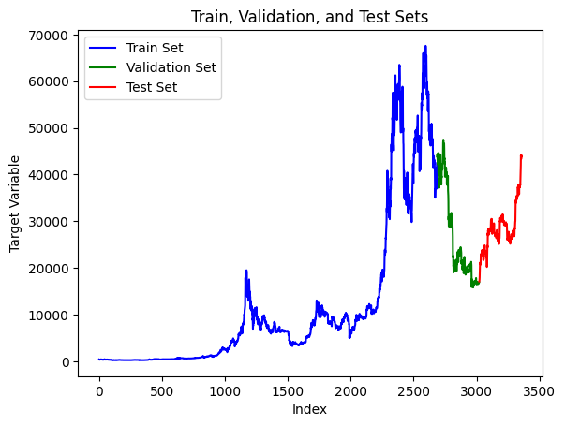

Slide 13
XGBoost Regression
In our pursuit of accurate Bitcoin price prediction, we leverage the power of XGBoost, a robust and widely acclaimed machine learning algorithm known for its efficiency in handling complex datasets and capturing intricate patterns.
To enhance the model's performance, we incorporate Principal Component Analysis (PCA) as a preprocessing step.
PCA helps streamline the dataset by reducing dimensionality, ensuring that XGBoost is trained on the most relevant features, thereby optimizing predictive accuracy.
Additionally, we employ Randomized Search Cross Validation (RandomSearchCV) to fine-tune XGBoost's hyperparameters.
This systematic approach ensures that our XGBoost model is not only adept at discerning patterns in Bitcoin price data but is also optimized for peak predictive performance.
In XGBoost regression for predicting Adj Close prices, historical stock data such as open, high, low prices, volume, and technical indicators serve as features, while the target variable is the corresponding 'TargetNextClose' price.

Slide 14
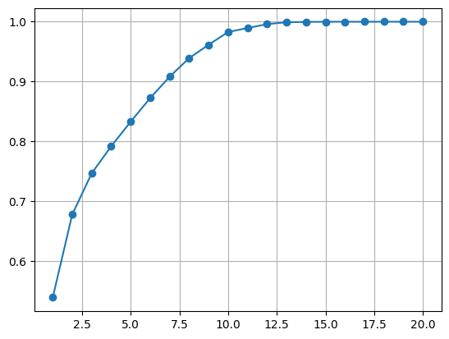
Upon visual inspection of the plot, the clear elbow point at 10 components is indicative of an optimal choice for PCA in streamlining the dataset for subsequent XGBoost training.

Slide 15
XGBoost’s performance metrics for both the training and validation sets
Metric | Training Set | Validation Set
Mean Squared Error | 984,574.19 | 15,346,403.40
Root Mean Squared Error | 992.26 | 3,917.45
R2 Score | 0.9962 | 0.8368
Mean Absolute Error | 607.60 | 3,067.71
Mean Absolute Percentage Error | 12.81% | 12.81%

Slide 16
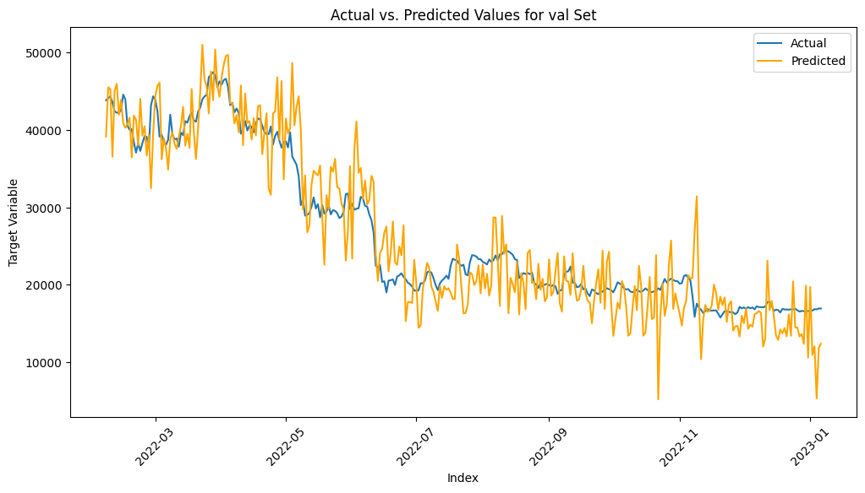

Slide 17
Long Short-Term Memory(LSTM)
LSTM selected for Bitcoin prediction due to its sequential data handling capabilities.
Data Transformation:Data transformed to fit LSTM's time step requirements for optimal prediction.
Callback Integration:EarlyStopping and ModelCheckpoint callbacks used to prevent overfitting and save optimal weights.
Optimization Parameters:ADAM optimizer with a learning rate of 0.001 chosen for a balanced convergence speed and accuracy.
Activation Function:Linear activation function employed to preserve numerical precision in Bitcoin price prediction.
Loss Function:Mean Squared Error (MSE) utilized as the loss function for accurate model optimization in Bitcoin forecasting.
Architecture Configuration:Three LSTM layers implemented with 150, 100, and 50 units, each incorporating a 0.2 dropout for regularization. The final Dense layer is employed for model output.
In LSTM for Bitcoin price prediction, historical price and volume data, along with relevant technical indicators, are utilized as features, while the target variable is the 'TargetNextClose' price.
References:
GeeksforGeeks. (2023, June 5). Understanding of LSTM networks. GeeksforGeeks. https://www.geeksforgeeks.org/understanding-of-lstm-networks/

Slide 18
LSTM’s performance metrics for both the training and validation sets
Metric | Training Set | Validation Set
R^2 Score | 0.9877 | 0.9733
Mean Squared Error (MSE) | 0.0007 | 0.0005
Root Mean Squared Error (RMSE) | 0.0266 | 0.0223
Mean Absolute Error (MAE) | 0.0215 | 0.0166
Mean Absolute Percentage Error (MAPE) | inf (Infinity) | 4.4864

Slide 19
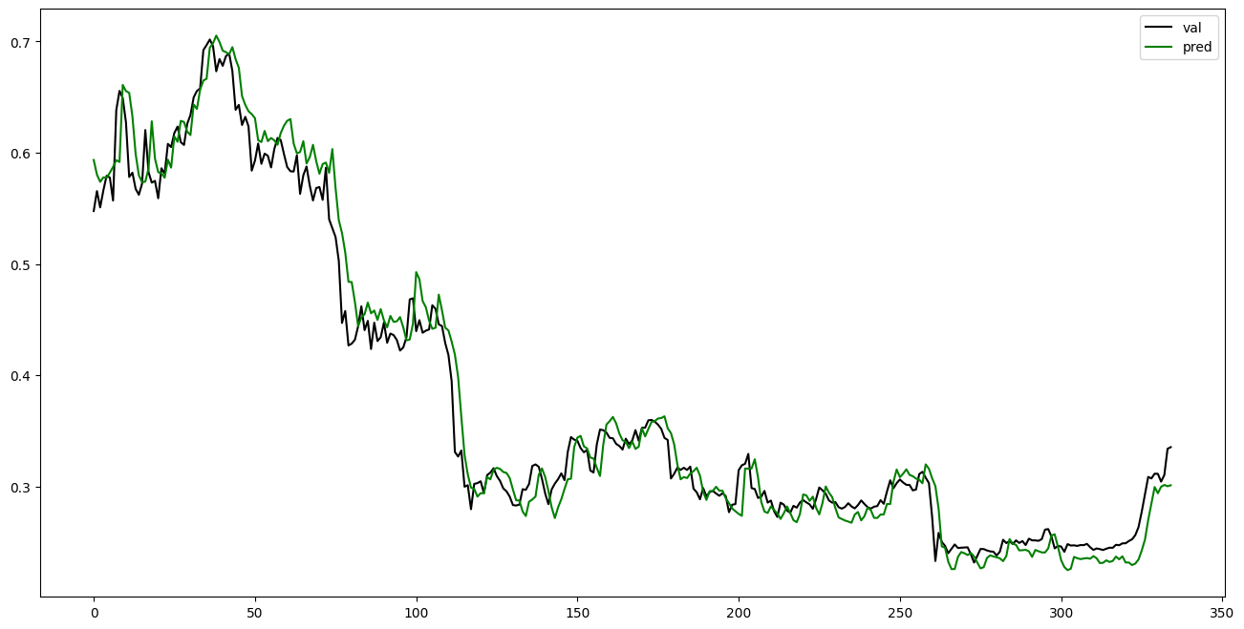

Slide 20
Autoregressive Integrated Moving Average (ARIMA)
ARIMA is preferred for Bitcoin forecasting due to its ability to handle seasonality, statistical rigor, simplicity, and interpretability.
Unlike XGBoost and LSTM, ARIMA is a statistical model, well-aligned with the transparent nature of financial data.
It is effective in dealing with non-stationary data and offers robust forecasting for short to medium-term predictions.
ARIMA's historical dependency modeling and adaptability make it valuable for traders and investors.
ARIMA is univariate, utilizing only historical Bitcoin prices as input features to forecast future prices as the target variable.

Slide 21
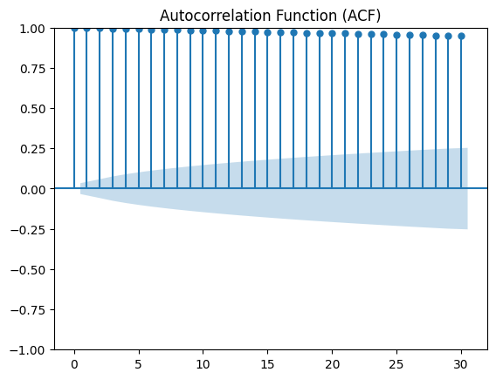
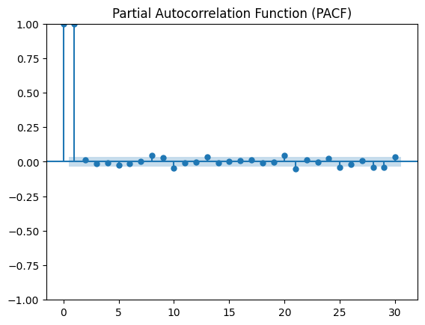
The ACF shows a strong, positive correlation that persists across several time lags, indicating a potential non-stationary time series, which is typical for financial data like Bitcoin prices.
The PACF indicates a significant correlation at the first lag and no significant correlations afterward.

Slide 22
Walk-forward Validation for ARIMA Model on Validation Data
Walk-forward validation is employed for ARIMA model evaluation in Bitcoin prediction as it dynamically updates the model with each new observation. This approach provides a more realistic simulation of how the model would perform in a real-world scenario, allowing for continuous adaptation to evolving patterns.
This analysis draws inspiration from the following link: ARIMA for Time Series Forecasting with Python.
ARIMA hyperparameters (p, d, q):
P (AR order): Chosen to capture weekly patterns in Bitcoin price movements, as financial markets often exhibit a seven-day cycle.
D (Integration order): A first-order differencing is applied to make the time series stationary.
Q (MA order): Selected to consider the impact of the last observed error term on the current value.
After experimenting with different p, q, d values (2, 1, 0; 0, 1, 18), we identified 5, 1, 0 as the optimal combination. The choice of p=5, d=1, q=0 aims to strike a balance between capturing meaningful patterns and maintaining model simplicity. However, future research will aim to explore potential hyperparameters for further model improvement.
References:
Brownlee, J. (2023, November 18). How to create an Arima model for time series forecasting in Python. MachineLearningMastery.com. https://machinelearningmastery.com/arima-for-time-series-forecasting-with-python/

Slide 23
ARIMA’s performance metrics for validation set
Metric | Validation Data
Mean Squared Error (MSE) | 939940.724
Root Mean Squared Error (RMSE) | 969.505
R-squared (R^2) Score | 0.990
Mean Absolute Error (MAE) | 621.933
Mean Absolute Percentage Error (MAPE) | 2.258%

Slide 24
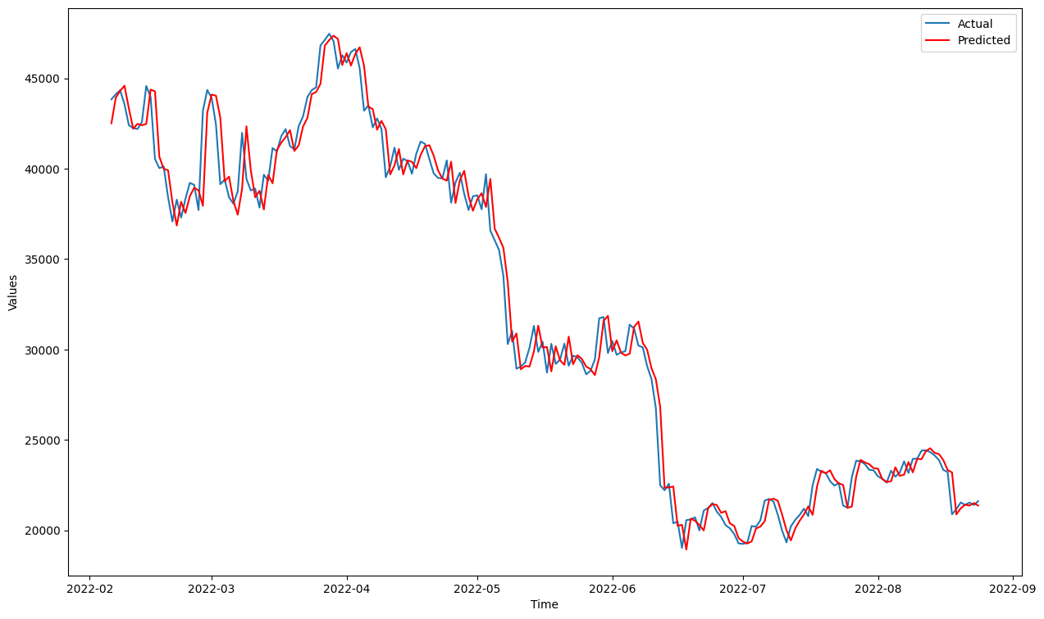

Slide 25
Model Evaluation
Here's a table summarizing the evaluation metrics for XGBoost, LSTM, and ARIMA models on the validation set:
Metric | XGBoost | LSTM | ARIMA
R-squared (R^2) Score | 0.8368 | 0.9733 | 0.990
Mean Absolute Percentage Error (MAPE) | 12.8127% | 4.4864% | 2.257%
Reasons for Choosing ARIMA:
Considering the comprehensive evaluation metrics, ARIMA emerges as the preferred model for this particular validation set. Its superior performance in terms of R-squared and MAPE suggests that ARIMA provides more accurate and reliable predictions compared to XGBoost and LSTM for the given data.
Statistical Model: ARIMA is a statistical time series model, and its strong performance on this dataset suggests that it captures the underlying patterns and trends effectively.
In summary, based on the evaluation metrics, ARIMA outperforms XGBoost and LSTM on the validation set, demonstrating higher accuracy and a better fit to the given time series data.

Slide 26
ARIMA’s prediction metrics on Testing set
Metric | Test Data
Mean Squared Error (MSE) | 409628.746
Root Mean Squared Error (RMSE) | 640.022
R-squared (R^2) Score | 0.982
Mean Absolute Error (MAE) | 428.725
Mean Absolute Percentage Error (MAPE) | 1.532%

Slide 27
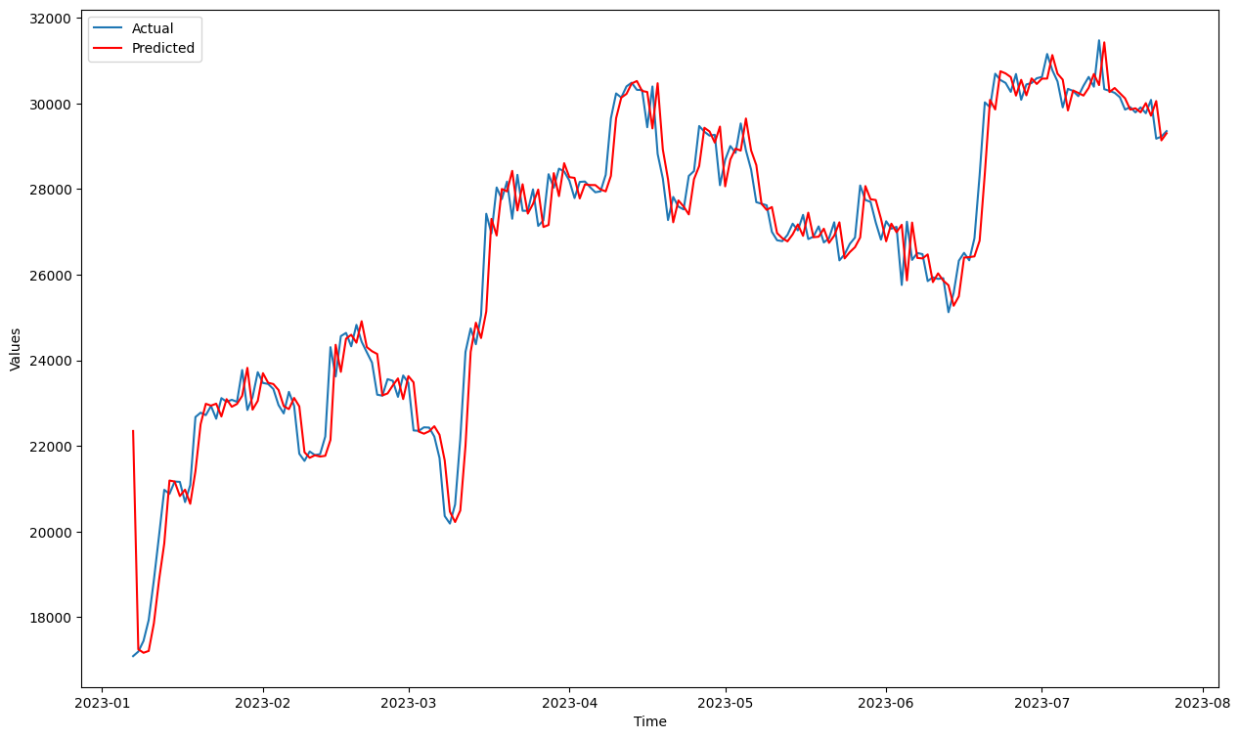

Slide 28
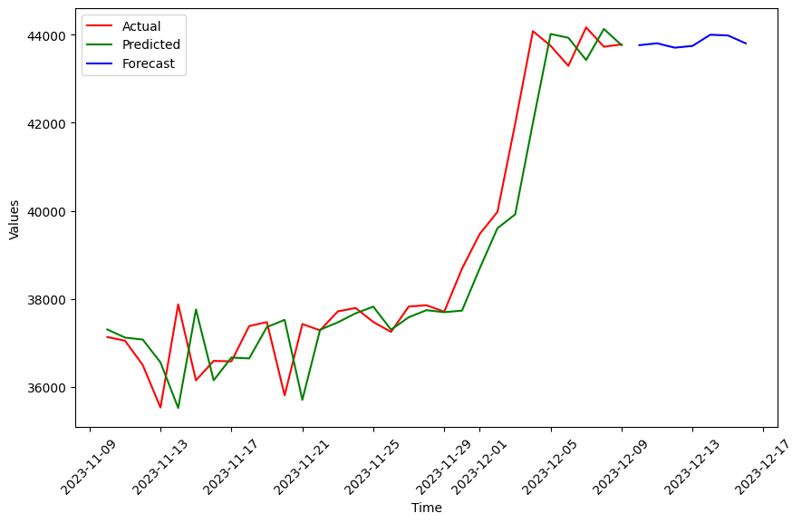
Forecast Next 7 Days with ARIMA Model
We find a strong degree of consistency between the projections produced by the ARIMA model and the actual Bitcoin closing prices based on historical data from Yahoo. This attests to the ARIMA model's predictive power for Bitcoin prices.

Slide 29
Insights and Future Scope
Insights:
ARIMA model shows high accuracy in predicting Bitcoin prices.
R-squared scores indicate a strong ability to capture complex patterns.
Low error metrics (MAE, MAPE) highlight precise predictions.
Future Scope:
Explore additional features for enhanced model understanding.
Investigate ensemble modeling for improved robustness.
Implement real-time model updating and optimization.
Develop user-friendly visualizations with Highcharts.
Integrate external datasets for a more comprehensive analysis.

Slide 30
References
Brownlee, J. (2023, November 18). How to create an Arima model for time series forecasting in Python. Retrieved from MachineLearningMastery.com: https://machinelearningmastery.com/arima-for-time-series-forecasting-with-python/
GeeksforGeeks. (2023, June 5). Understanding of LSTM networks. Retrieved from GeeksforGeeks: https://www.geeksforgeeks.org/understanding-of-lstm-networks/
Levi, K. L. (2023, May 22). Best 10 indicators for cryptocurrency trading: Primexbt&nbsp. Retrieved from PrimeXBT: https://primexbt.com/for-traders/best-indicators-for-cryptocurrency-trading/
Narayanan, A., Bonneau, J., Felten, E., Miller, A., & Goldfeder, S. (2016). Bitcoin and cryptocurrency technologies: a comprehensive introduction. Princeton University Press.
Tambe, N. (2023, December 6). Bitcoin price prediction: Can Bitcoin reach $1,000,000 by 2025? Retrieved from Forbes: https://www.forbes.com/advisor/in/investing/cryptocurrency/bitcoin-prediction/
Yahoo! (2023, December 19). Bitcoin USD (BTC-USD) price history &amp; historical data. Retrieved from Yahoo! Finance: https://finance.yahoo.com/quote/BTC-USD/history/?guccounter=1

Slide 31
Thank You…

